Slide 1


Sequential Circuits – Circuits with Memory
The main categories and common uses are:
No clock – latches
Nand latch – debounce switches
Latch an alarm siren (light beam burglar alarm
in Digital 1 course.
Clocked
Clock level – Flip flips and RAM
Clock edge – Flip flops and RAM
Clock edge is the most common in FPGAs
Flip flop timing requirements (setup, hold,
propagation delay) are very important in FPGAs

Slide 2
SBAR RBAR Q
0 0 illegal
0 1 1
1 0 0
1 1 no change

Slide 3
Outputs with BUFFER mode can be fed back in.

Slide 4
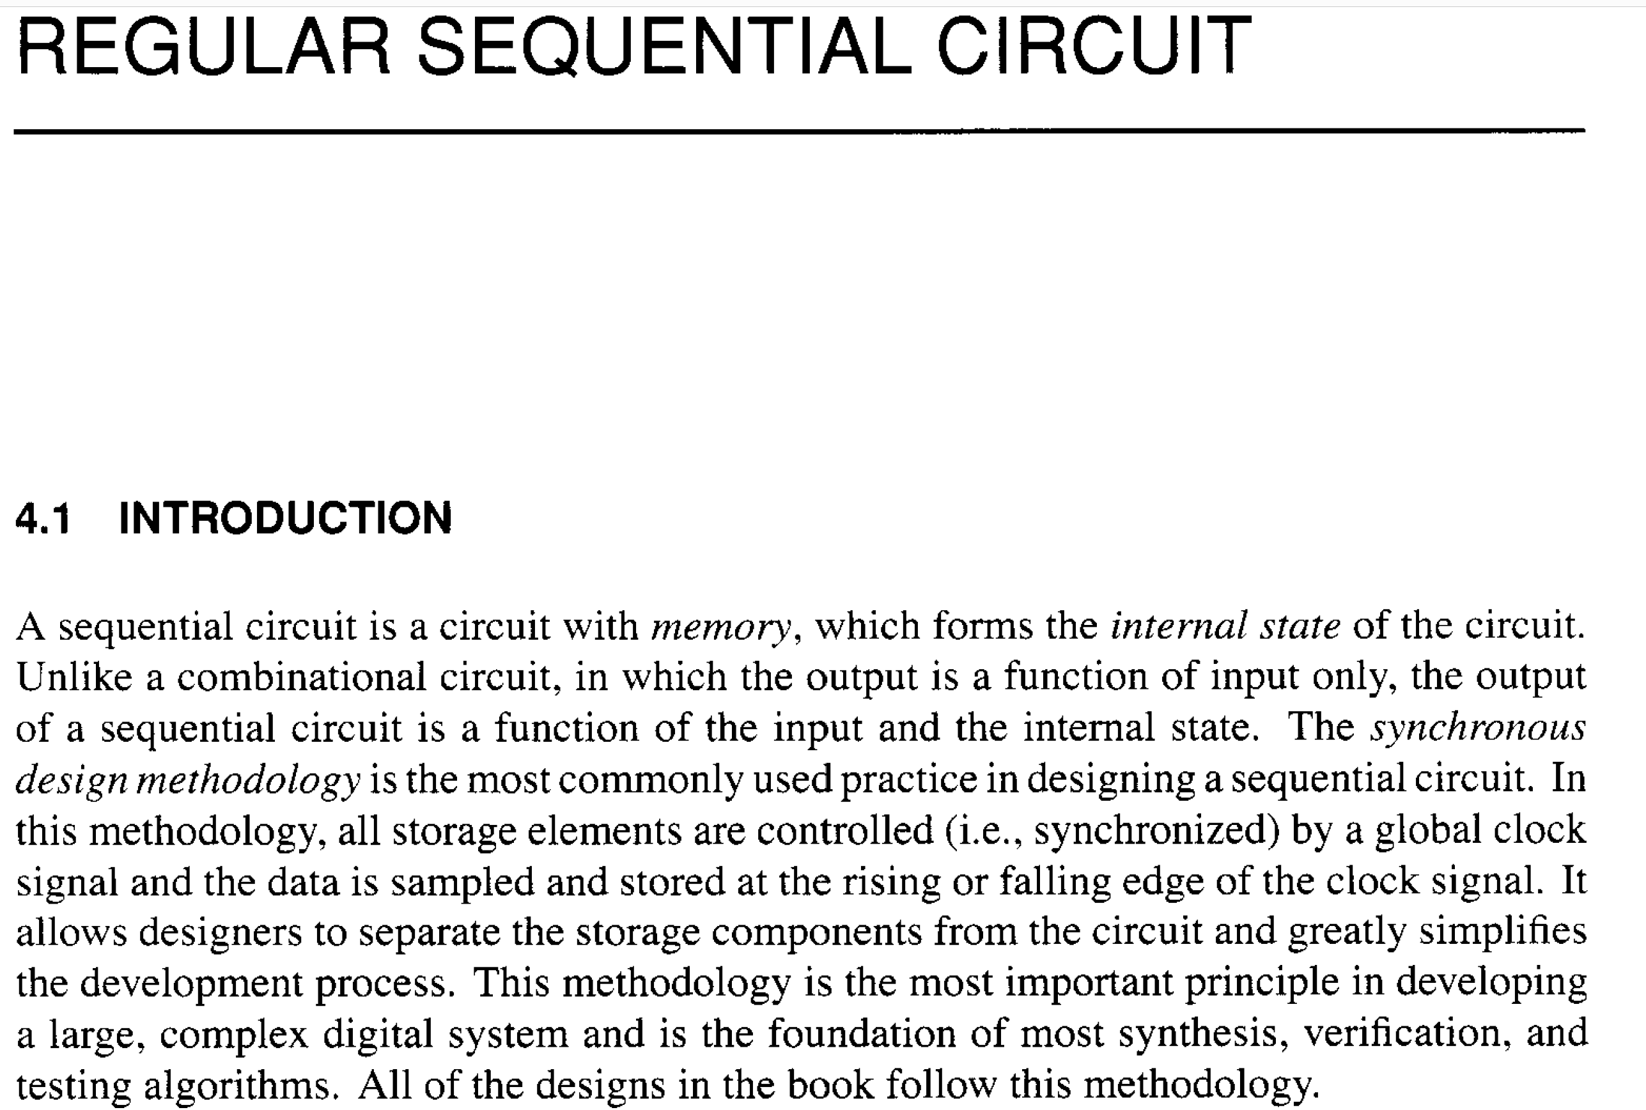










Chu FPGA by VHDL Examples text Ch. 4

Slide 5
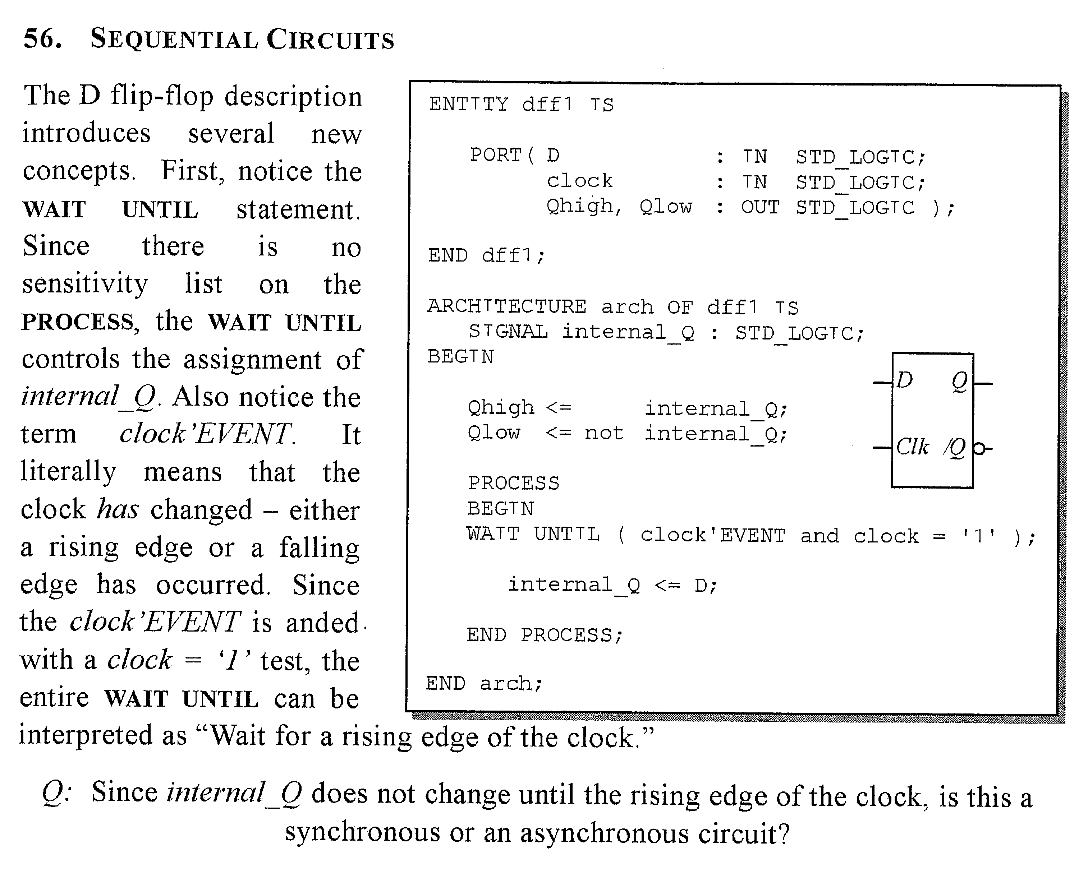









Wait Until can only be used with a clock.
Input D would not be in sensitivity list.
Signals assigned in a clocked process create D FFs
Left side of <= is assigned

Slide 6
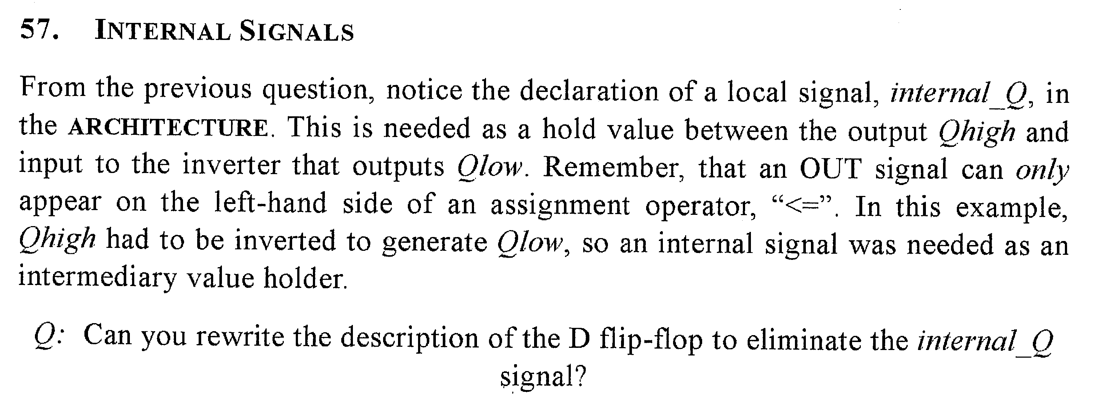




Slide 7
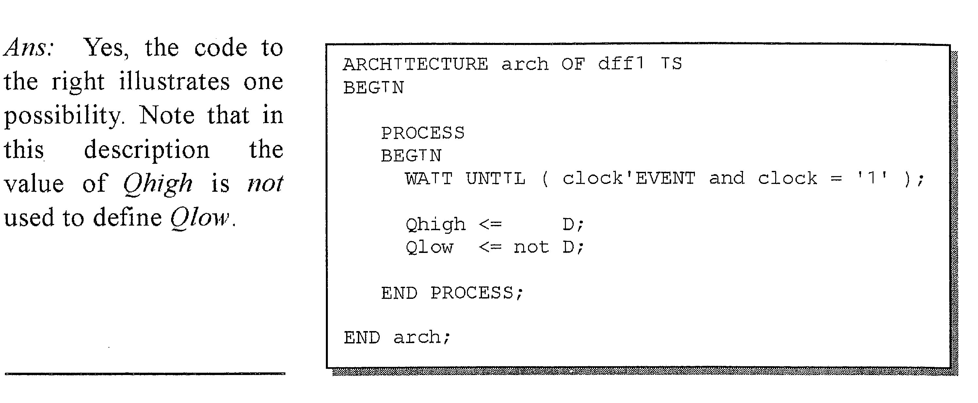



Slide 8
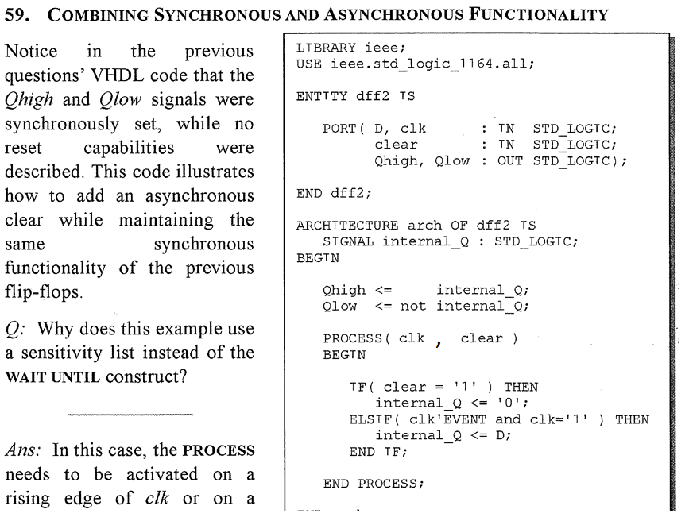










Wait Until is for clock only, no sensitivity.

Slide 9
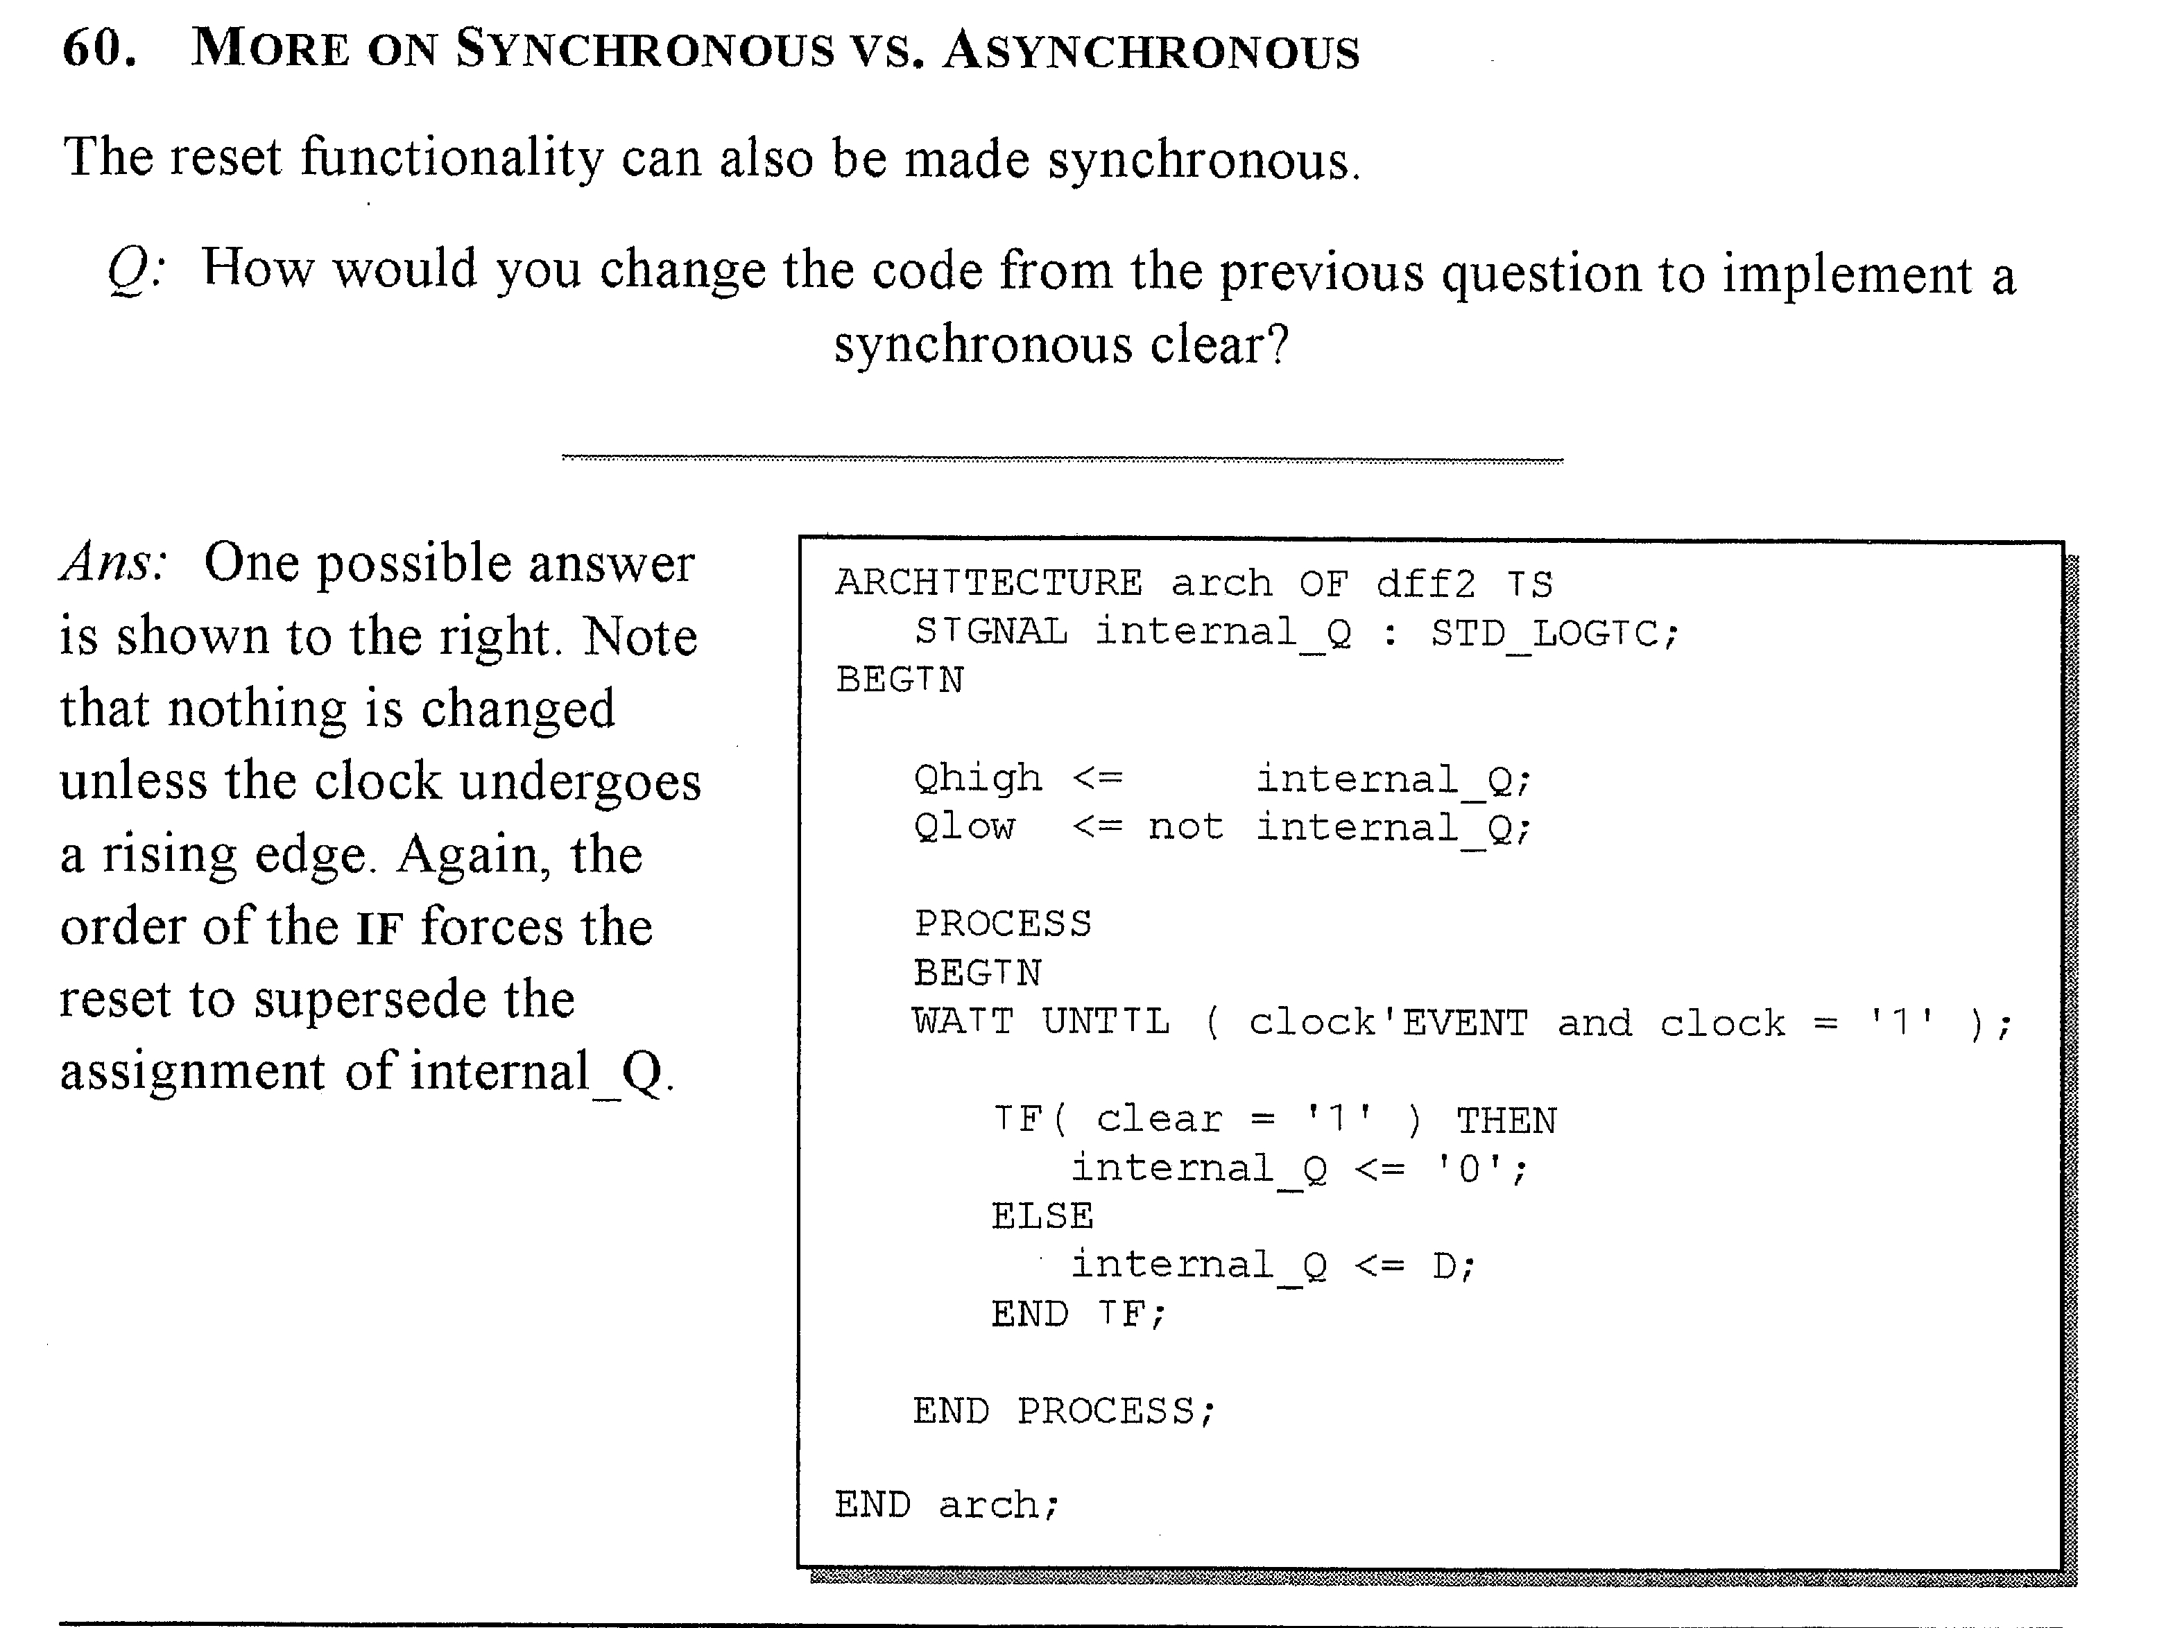






Put clear under
clock event.

Slide 10









Slide 11
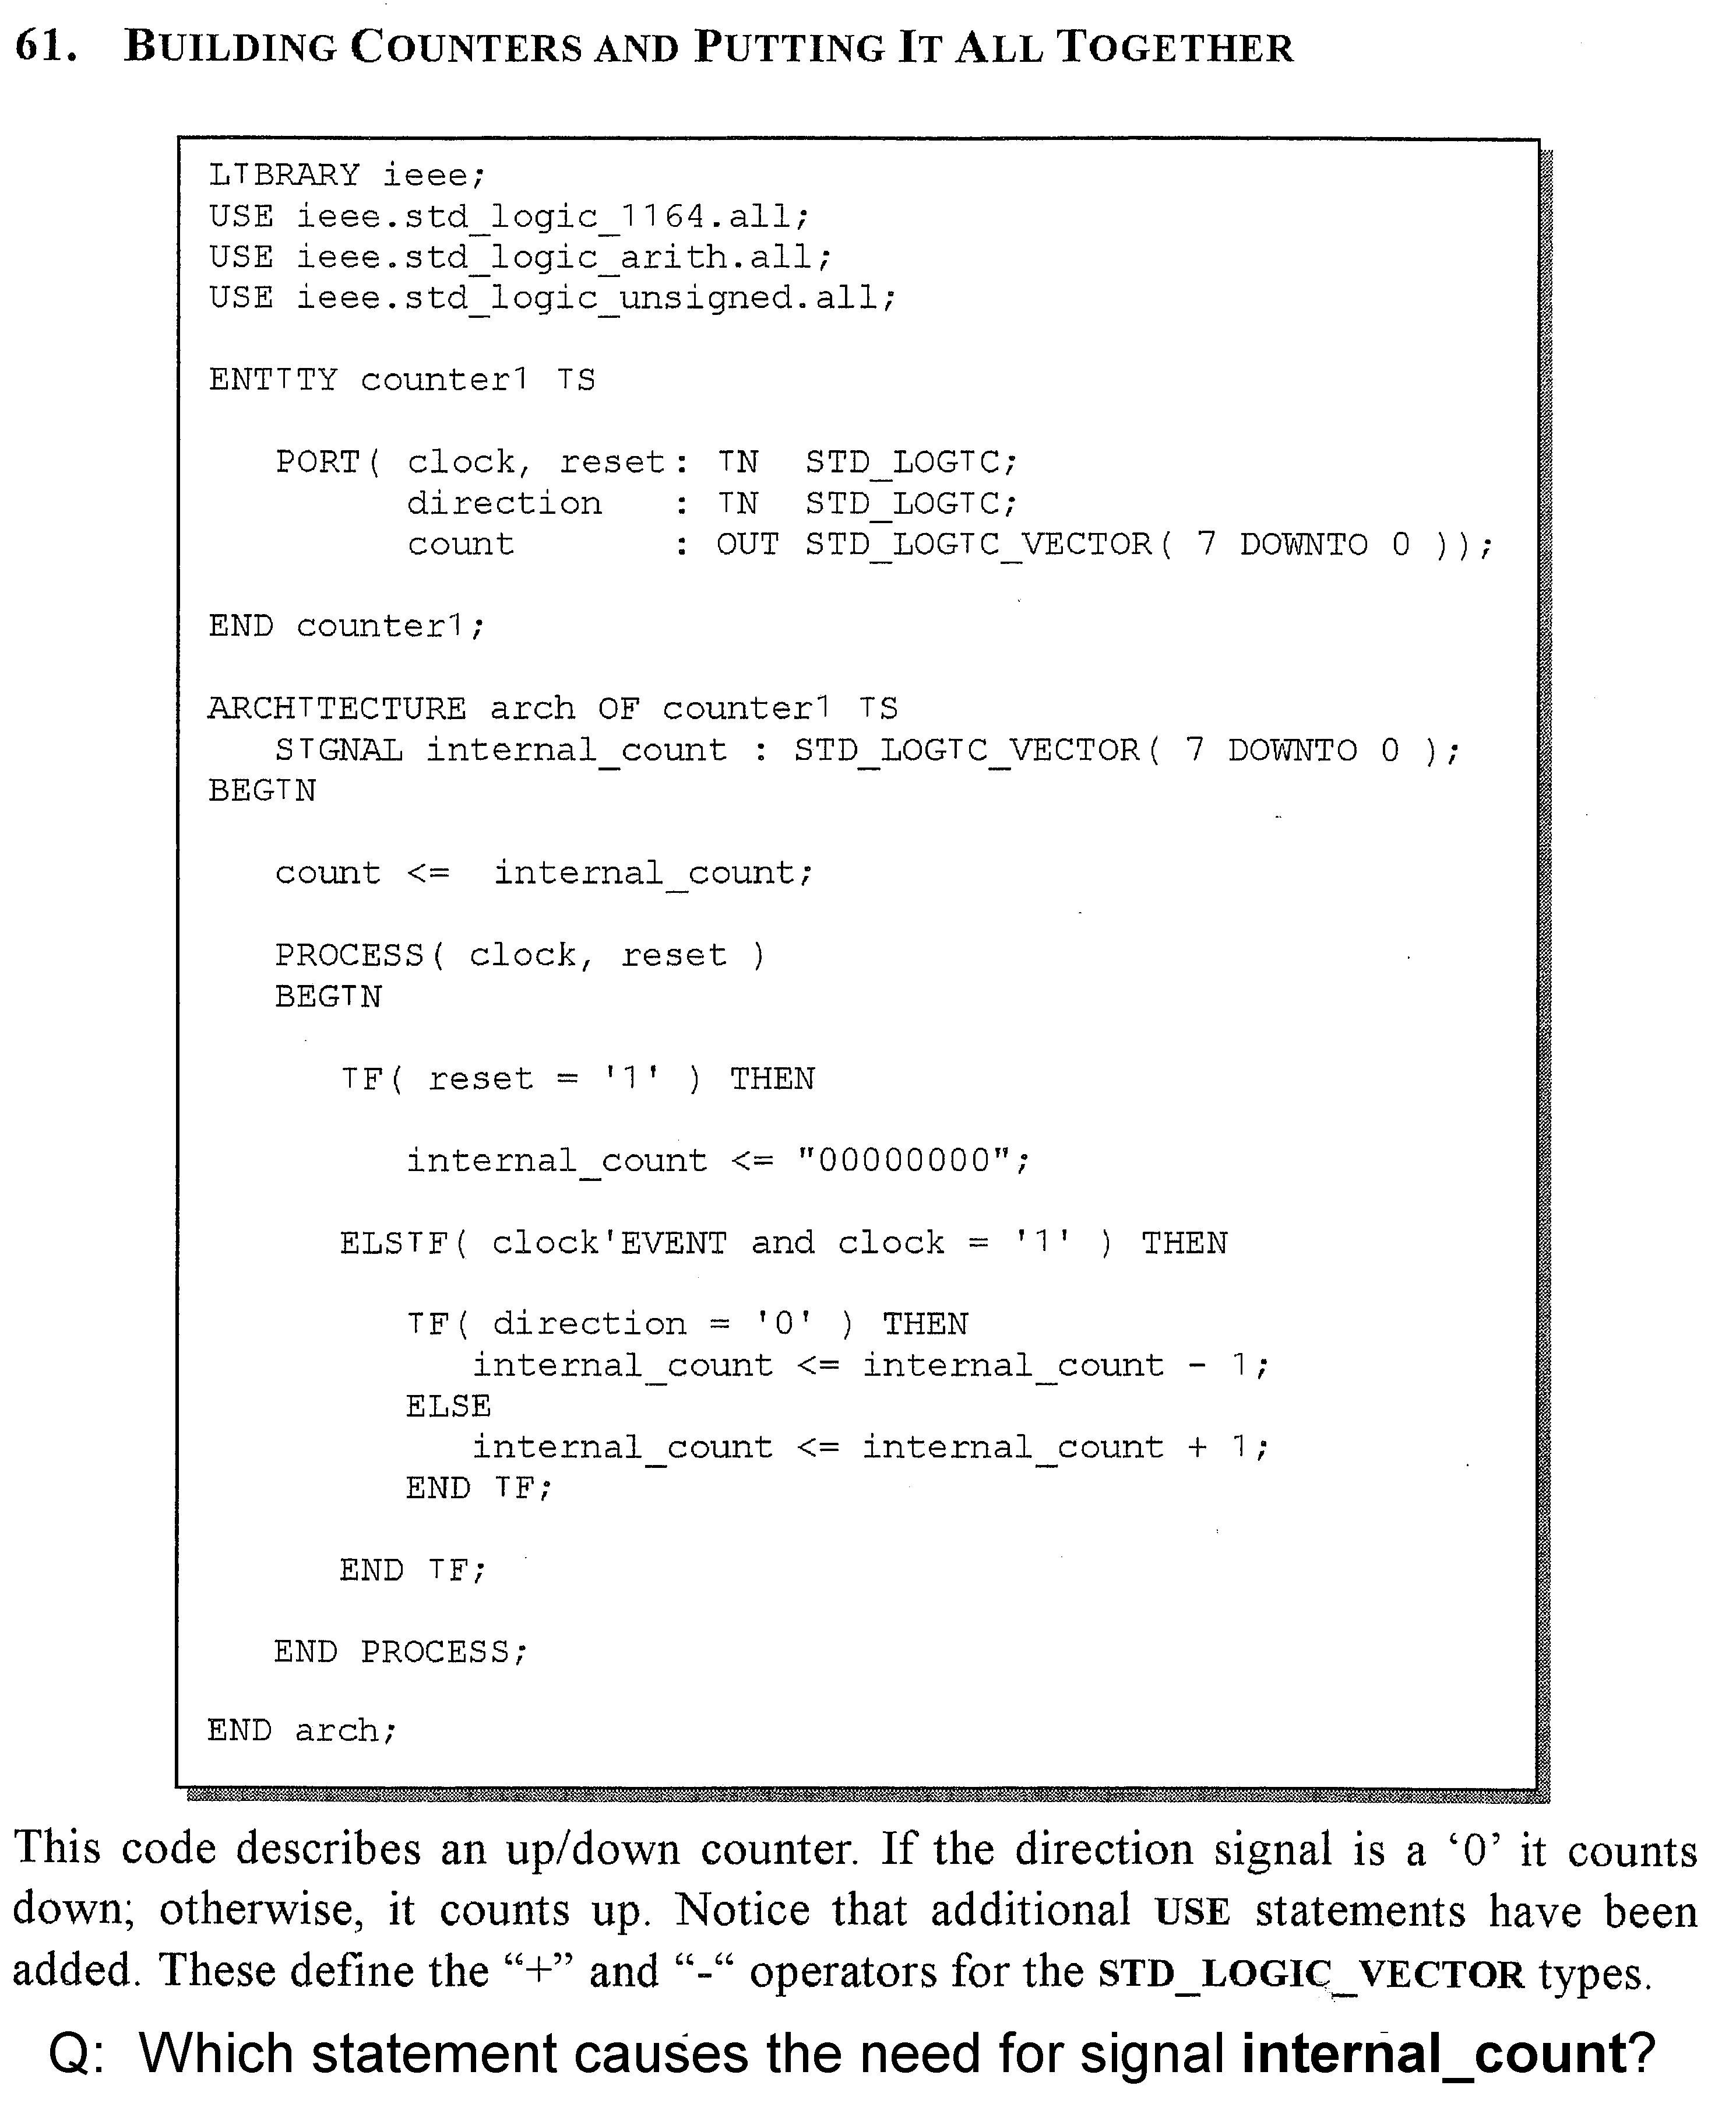




ieee.numeric_std.all;
UNSIGNED (7 DOWNTO 0);
std_logic_vector(internal_count);

Slide 12
SIGNAL rules summary (see NandLand.com,
“Variables vs Signals”)
Signals can be used both inside and outside processes.
A signal can be used in multiple processes,
but only assigned in one of them.
3. Signals are defined in the ARCHITECTURE before BEGIN.
4. Signals are assigned using <= .
5. Signals take the assignment immediately if it is a
combinatorial circuit, but after the clock if it is a
sequential circuit because it generates a FF.
6. Signals used in a process end up with the last value assigned to them
(see Chu Ch. 3 p. 47).

Slide 13
VARIABLE rules summary (NandLand.com, “Variable”)
Can only be used inside process.
Are local – not usable outside that process.
Defined after PROCESS and before BEGIN.
Assigned using := , which acts immediately.
If something uses the value of a variable before the assignment,
it will be different than the value after the assignment.
In a clocked segment, if a variable is used before it is assigned
a value, it will be latched. Conversely, if it is assigned a value
before it is used, it will not be latched.
7. Variables can be tricky, and can be hard for Quartus to synthesize.

Slide 14
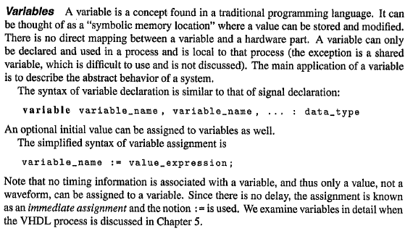







Chu RTL text Ch. 3 p. 49

Slide 15
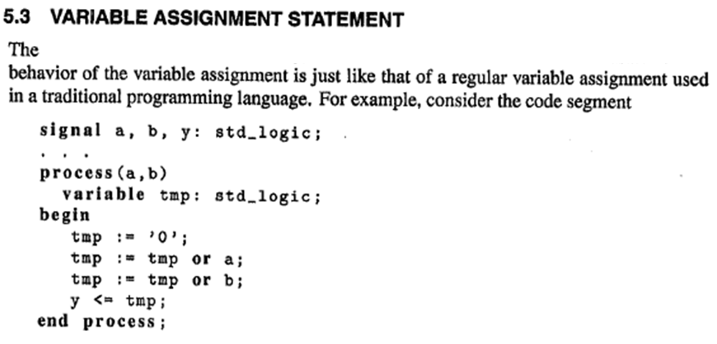



Chu RTL text Ch. 5 p. 101
Combinatorial Circuit
tmp gets these values in order: 0, a, a OR b; so y ends up with a OR b.
But this does not implement a two-input or-gate circuit,
it is just a value stored somewhere.

Slide 16
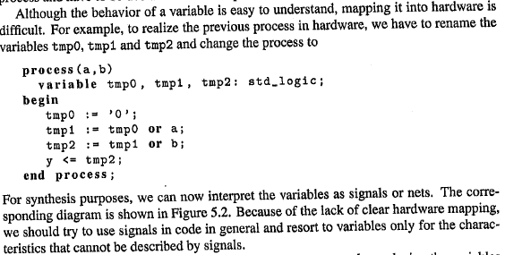
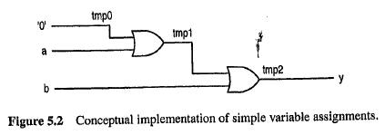



Slide 17
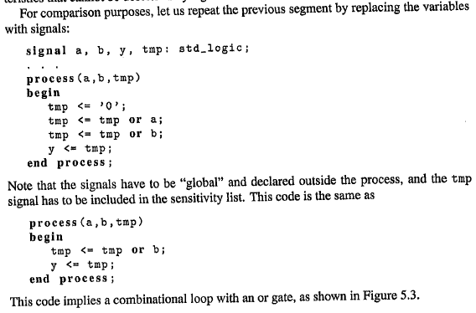
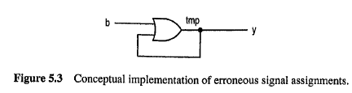















Because a signal in a process takes
the last value assigned to it.
See p. 47 in Chu FPGA text.

Slide 18
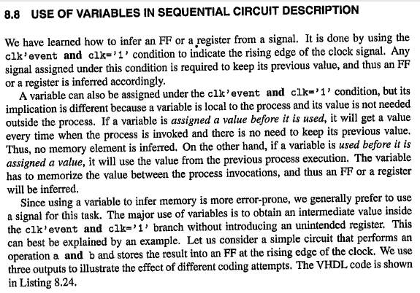














Chu RTL text Ch. 5 p. 250
Assigned is left hand side of <=

Slide 19
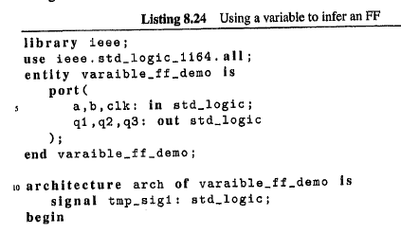
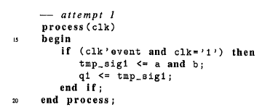



Slide 20
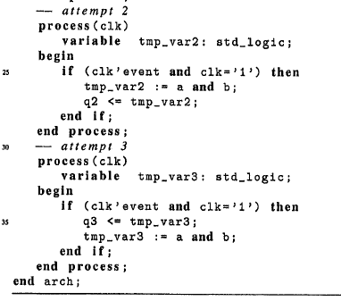





Slide 21
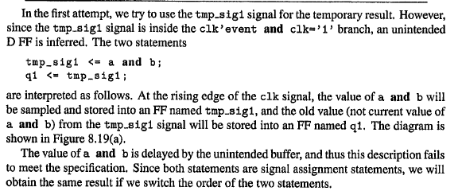
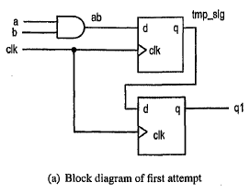








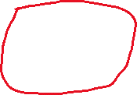



tmp_sig1 is assigned a value ( left hand side of <=)
concurrent

Slide 22
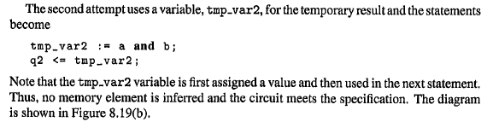
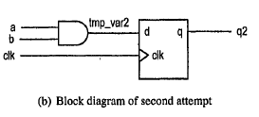



Assigned first
Used second

Slide 23
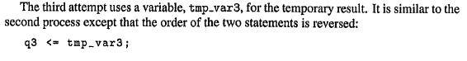
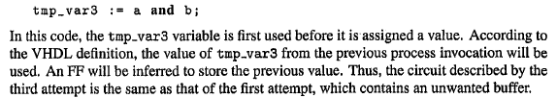
Used first
Assigned second

Slide 24
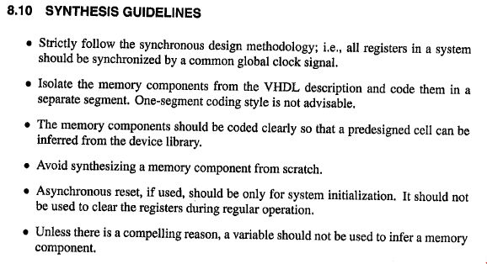


Chu RTL text Ch. 5 p. 253
RAM, ROM, FIFO, etc.

Slide 25
Not a good reason to use a
variable since used it to make
a FF. Should use a signal for the FF.
variable is used before assigned a value
so it makes a FF
variable is local to process, so do this INSIDE process

Slide 26
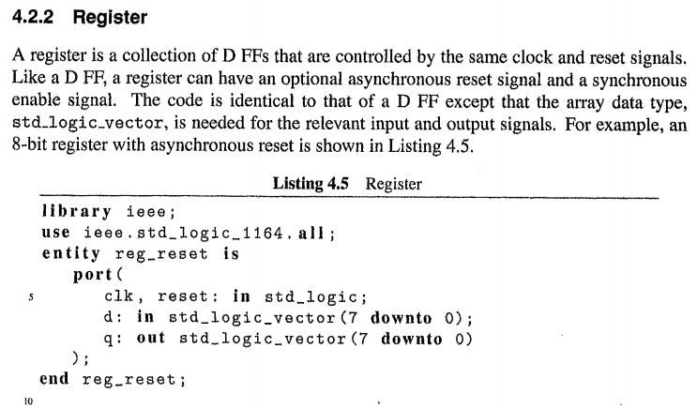
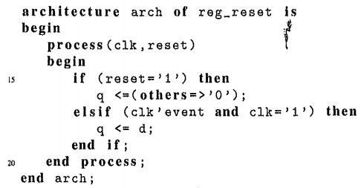


Chu Ch. 4 p. 77
(uses =>)
The (others => ‘0’) means “00000…”,
a variable number of zeroes, which is needed when
the signal is defined using a generic number of bits.

Slide 27
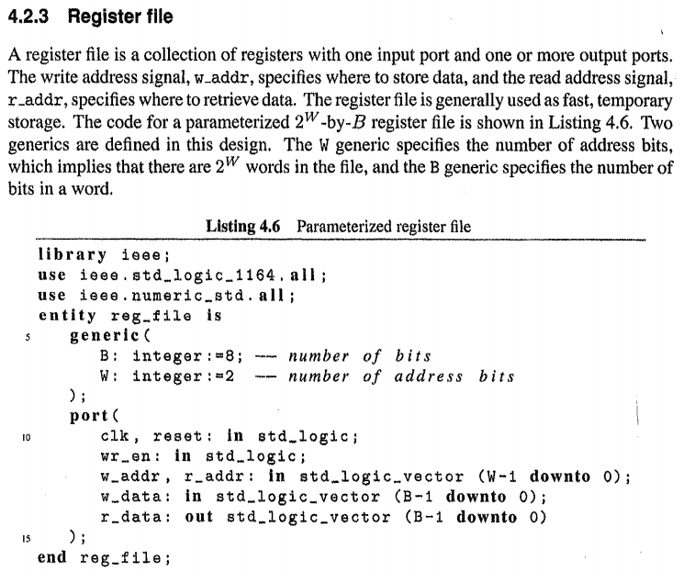





















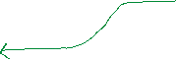







Chu Ch. 4 p. 78
Similar to static RAM,
but no read pin.
Need numeric for conversions
between std_logic pins and integers.
8-bit reg
8-bit reg
8-bit reg
8-bit reg
Don’t need read pin: data always on output

Slide 28
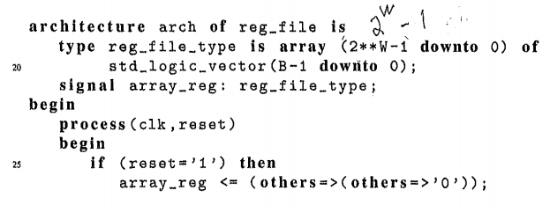
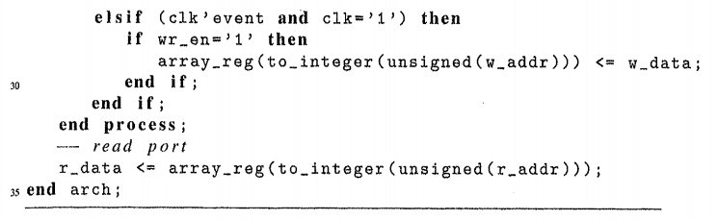






4-byte memory
array (element #)
StdLogicVector
integer
Integers are used for array element #
4 elements
8 bits
StdLogic
pin
ALWAYS output the data from the read address (no read pin)
array (element #)
StdLogic
pin
StdLogicVector
integer

Slide 29
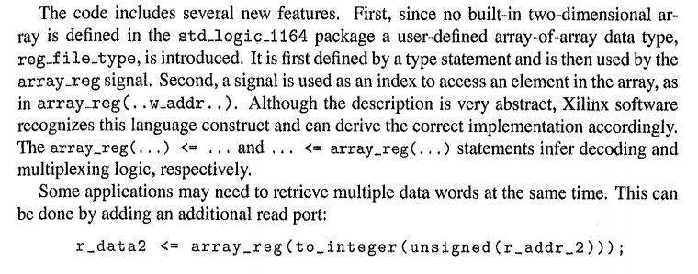








write
read
8-bit reg
1 to 4
decoder
8-bit reg
4 to 1
mux
8-bit reg
8-bit reg
WRITE
READ
The (others => ‘0’) on the previous slide means “00000…”,
a variable number of zeroes, which is needed
when the signal is defined using a generic number of bits.

Slide 30
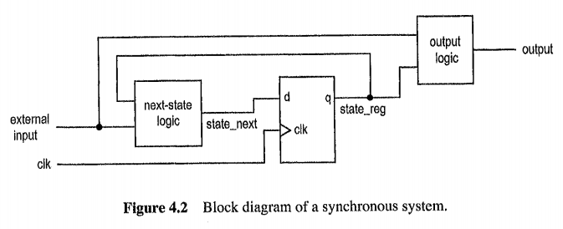
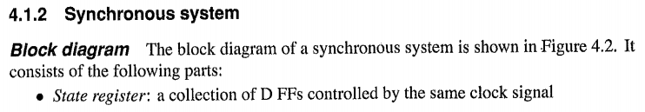
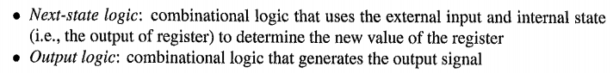










Chu Ch. 4 p. 72

Slide 31
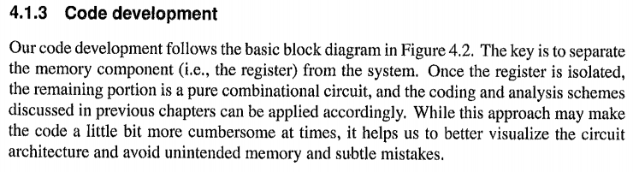
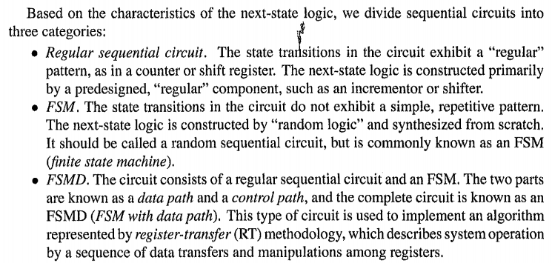








Slide 32
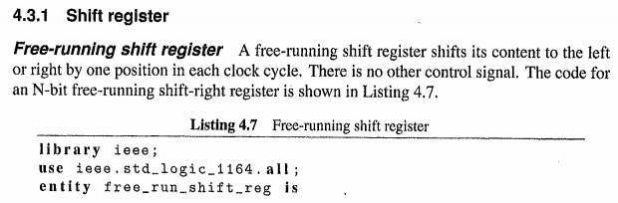
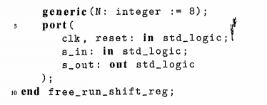




Regular Sequential Circuit Chu Ch. 4 p. 79

Slide 33
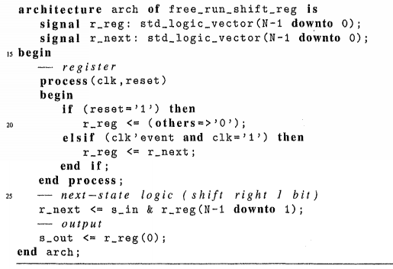
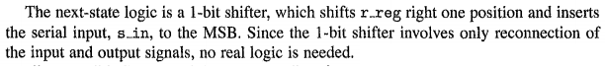









See earlier slide on section 4.1.2

Slide 34
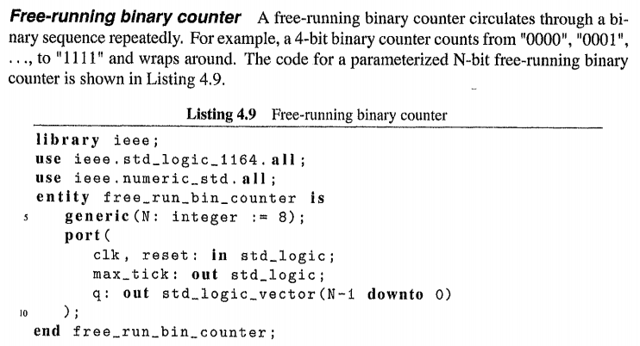




Regular Sequential Circuit Chu Ch. 4 p. 81
Carry Out when counter rolls over

Slide 35
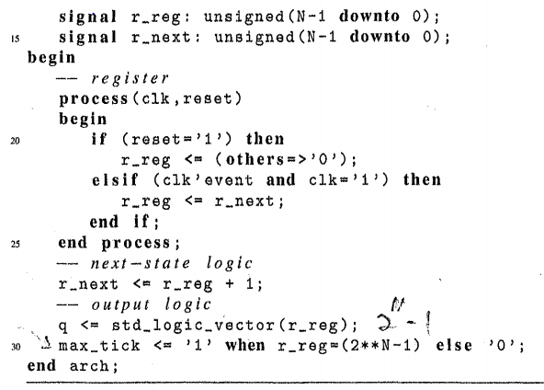










See earlier slide on section 4.1.2
Use numeric (unsigned) for math

Slide 36
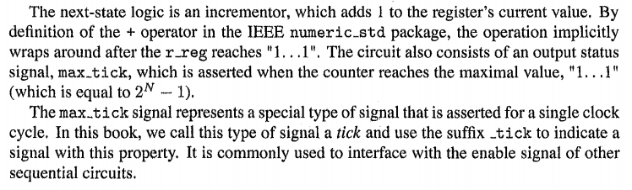








Most texts call this tick signal the “carry out” when it is for a counter.
It is called a tick because is only lasts for one clock cycle, which allows
it to be used to trigger the start of a “downstream” component.

Slide 37
MODELSIM TEST BENCH for Sequential Circuits
The test bench for a sequential circuit is more complicated than
one for a combinatorial circuit.
A sequential circuit has clock-edge flip flops, so the test bench
uses a continuous clock signal.
The flips flops have timing constraints that must be satisfied,
such as setup and hold times.
If the flip flops use the rising edge of the clock, the inputs to the
flip flops should be changed on the falling edge to allow
plenty of setup time.
FSM inputs should also be changed on the falling edge
for the same reason.

Slide 38
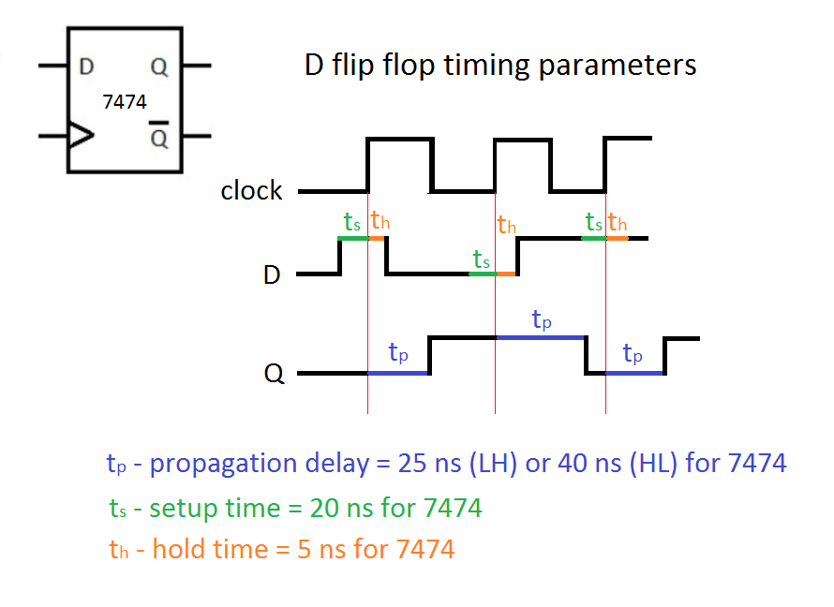
falling
edge
stable inputs

Slide 39
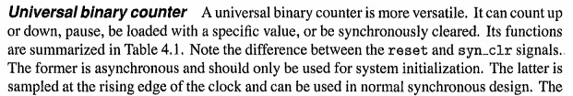
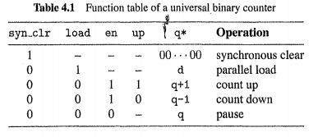


This counter will be used in the ModelSim sequential testbench.
The design of this counter is usually a lab assignment.

Slide 40
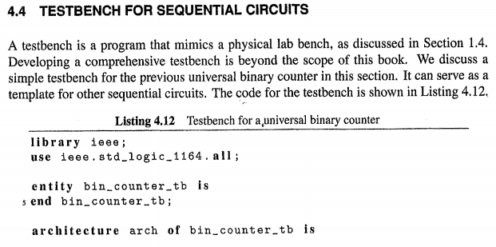
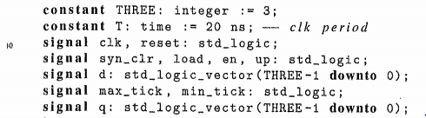




Regular Sequential Circuit Chu Ch. 4 p. 84
Uses the actual counter as a component.
These are simulation signals that get
connected to the component.
Creating a 3-bit counter
Keyword time is a data type
(for simulations)

Slide 41
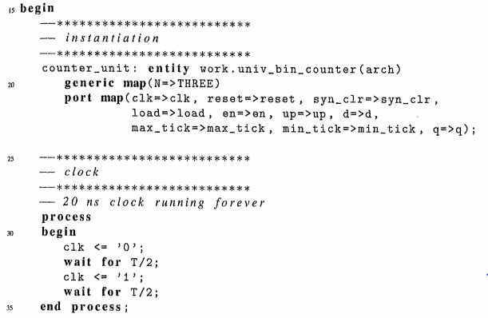


of the counter component
Not a real clock, this is simulation!
Can’t use “wait for” for synthesis.
Test benches are compiled and
run in Model Sim.
20 ns --- 50 MHz
(same as Altera DE2 real clock)

Slide 42



Active high
Counter component uses rising edge clock,
so change input signals on falling edge so
counter FFs have plenty of setup time.

Slide 43












Slide 44










www.NandLand.com
Wait UNTIL – condition is true
After these wait statements,
make sure input does not change
on rising edge of clock.
Wait ON – signal changes
Wait FOR - time
Use these!

Slide 45












Slide 46



Slide 47









Slide 48






Chu RTL Ch. 8 p. 72
Figure 8.5

Slide 49





Slide 50








Slide 51






Reasons not to use the one-segment style.

Slide 52








Chu Ch.4 p. 100
(tail)
(head)
(pronounced with a long I, as in “file”)
e.g., two subsystems on
different clock frequencies
typotail
and in the Altera library of parameterized modules

Slide 53


Slide 54




rd=wr
tail
head
Last operation was a write
wr=rd
How do you distinguish these two cases?
9 - 1 = 8
rd=wr
Last operation was a read

Slide 55

FIFO controller has 2-bit control SIGNAL wr_op (concatenated from RD and WR pins) “00” No Op
“01” READ
“10” WRITE
“11” READ and WRITE

Slide 56


Natural is same as Integer but without the zero
16-byte FIFO
No address pins are needed because the FIFO read and write addresses
are manipulated internally using pointers (registers)

Slide 57

User type: 2-dimensional array
15
8
Internal address registers,
i.e., pointers
successive
-- flags

Slide 58

(segment 1 )
-- write port
-- if enabled
Pointers keep track of
where you are in the FIFO.
(segment 2 )
(always)

Slide 59


Memory (segment 1 cont’d)
Variable number of zeros
to match generic definition
-- D FF flags

Slide 60

Combinatorial logic (segment 2 cont’d)
“middle men”
Sensitivity includes ALL inputs to combinatorial
circuits, usually on right side of <= below
-- default NS values (keep old values)
-- they can be overridden below
--
--
-- use default values
--( can’t be full if just did a read)
If RD will equal WR due to this read
operation, then FIFO will be empty after
this read.

Slide 61


(can’t be empty if just did a write)
If WR will equal RD due to this write
operation, then FIFO will be full after
this write.
11
Cancels out, so no change
to full or empty
-- send flags out to pins

Slide 62










4
will not be using 3 of these LEDs
Using top-level hierarchy to implement the generic
FIFO as 4 word x 3 bit FIFO and wire up inputs to
debounced buttons and outputs to LEDs

Slide 63












Slide 64







Sequential Circuit Design Chu Ch. 9 Section 9.1
SSI – small scale integration
MSI – medium scale integration

Slide 65











After propagation delay

Slide 66









Chapter 6 Wiatrowski – Combinatorial circuits can have HAZARDS that generate glitches.

Slide 67





Slide 68




Cont’d
Also, the and gate’s (cell’s) propagation delay creates clock skew.

Slide 69




Slide 70





Clock Dividers
Global low-skew clock lines

Slide 71





Slide 72




Qs, not Carry Out Pins
# of
Qs
# of
clock
divider
seconds
clock
minutes
clock
Qs
1 Hz
1/60 Hz
1 MHz
1/60 Hz is once a minute

Slide 73






Using an AND gate with
inverters on certain inputs.
# of
# of
Pulses once/sec
once/60sec

